Slide 1
Semantic Image Segmentation with Deep Convolutional Nets and Fully Connected CRFs, ICLR2015
COMPUTER VISION LAB
22211226 Ju-Hyeon Nam

Slide 2
Contents
Introduction
Convolutional Neural Networks for Dense Image Labeling
Detailed Boundary Recovery : Fully-Connected Conditional Random Fields and Multi-Scale Prediction
Experimental Evaluation

Slide 3
Introduction
Segmentation in Deep Learning
Technical Problem of DCNN
Signal Downsampling ⇒ Reduction of signal resolution(max-pooling + downsampling)
Atrous Algorithm(Hole Algorithm)
Spatial Insensitivity(Invariance)
DCNN need invariance to spatial transformations in order to make object-centric inferences.
Limiting spatial accuracy of the DCNN?
Full-Connected Conditional Random Field(CRF)
DeepLab
Speed : Atrous Algorithm
Accuracy : SOTA in PASCAL semantic segmentation Challenge
Simplicity : DCNN + CRF

Slide 4
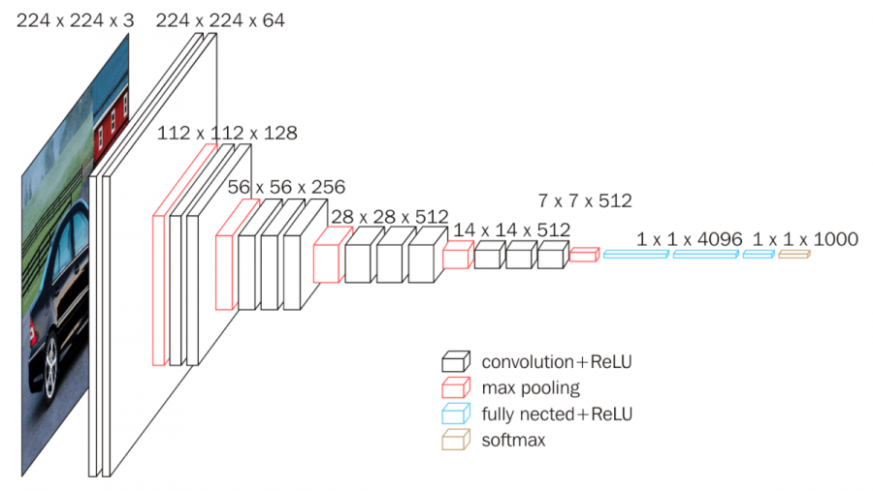
Convolutional Neural Networks for Dense Image Labeling
Efficient Dense Sliding Window Feature Extraction with Hole Algorithm
Methology
Convert the FCL of VGG16 into convolutional ones.

Slide 5
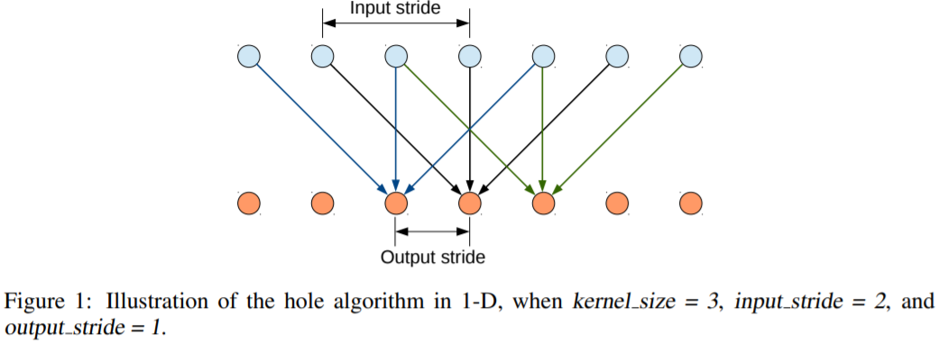
Convolutional Neural Networks for Dense Image Labeling
Efficient Dense Sliding Window Feature Extraction with Hole Algorithm
Methology
Convert the FCL of VGG16 into convolutional ones.
Run the modified network in a convolutional fashion on the image at its original resolution
If the last layer is FCL, all input images must be of a fixed size.
Skip subsampling after the last two max-pooling layers in the network
Modify the convolutional filters = Atrous Algorithm
Introducing zeros to increase their length

Slide 6
Convolutional Neural Networks for Dense Image Labeling
Efficient Dense Sliding Window Feature Extraction with Hole Algorithm
Atrous Convolution

Slide 7
Convolutional Neural Networks for Dense Image Labeling
Efficient Dense Sliding Window Feature Extraction with Hole Algorithm
Methology
Convert the FCL of VGG16 into convolutional ones.
Run the modified network in a convolutional fashion on the image at its original resolution
If the last layer is FCL, all input images must be of a fixed size.
Skip subsampling after the last two max-pooling layers in the network
Modify the convolutional filters = Atrous Algorithm
Introducing zeros to increase their length
Fine Tuning the model weights of the Imagenet-pretrained VGG16 to adapt it to the image classification task in a straightforward fashion.
1000-way Imagenet classifier ⇒ 21-way classifier
Loss function : Sum of cross-entropy terms for each spatial position in the CNN
All position and labels are equally weighted in the overall loss function
Bilinear Interpolation

Slide 8
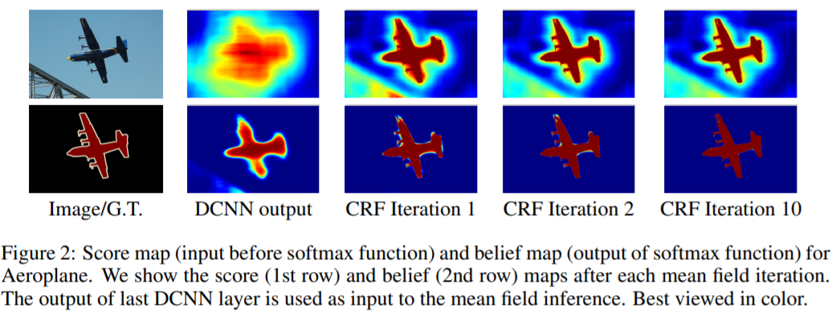
Detailed Boundary Recovery : Fully-Connected Conditional Random Fields and Multi-Scale Prediction
Deep Convolutional Networks and The Localization Challenge

Slide 9
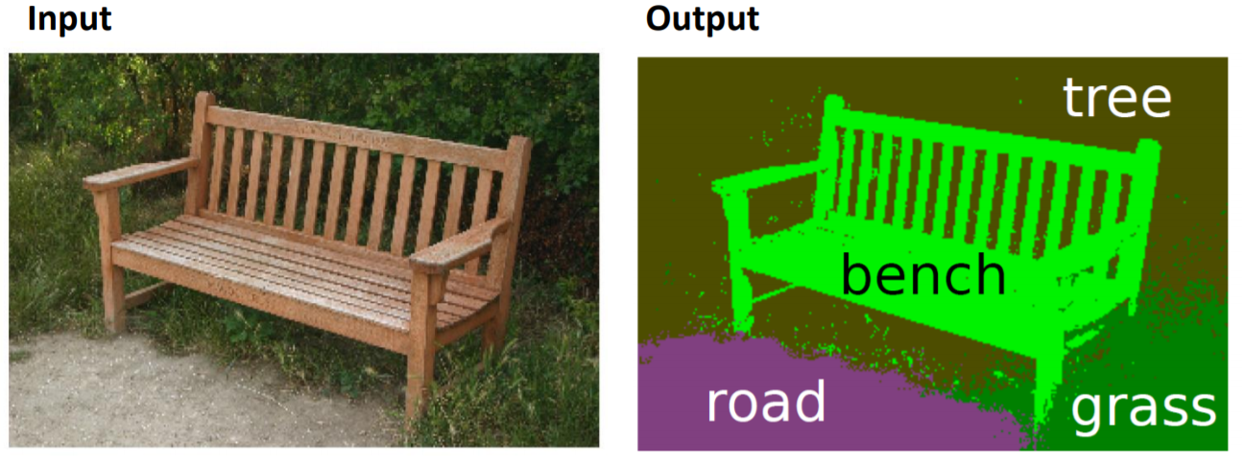

Detailed Boundary Recovery : Fully-Connected Conditional Random Fields and Multi-Scale Prediction
Fully-Connected Conditional Random Field for Accuracy Localization
Conditional Random Field
$$E\left(x | I\right)=\sum_{i}{φ_{u}(x_{i}|I)}+\sum_{i}{\sum_{j∈∂i}{φ_{p}(x_{i},x_{j}|I)}}$$
$X,I$ : Random Field
Unary Term
Pairwise Term

Slide 10
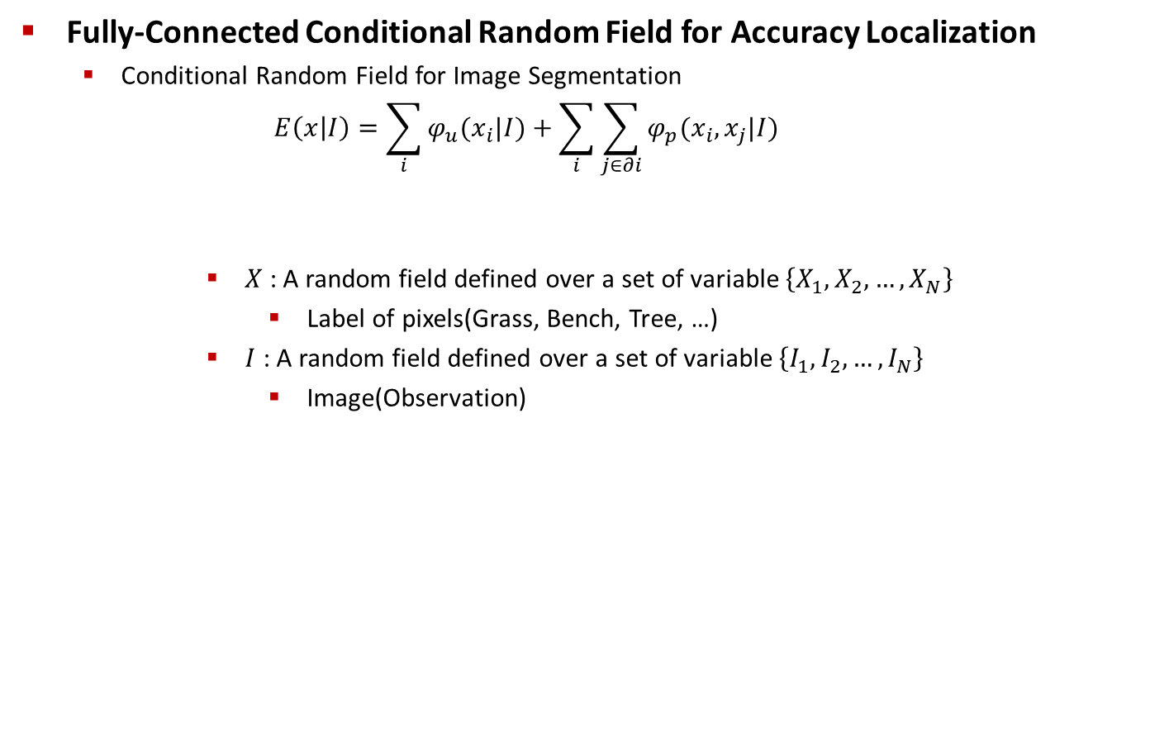
Detailed Boundary Recovery : Fully-Connected Conditional Random Fields and Multi-Scale Prediction
Fully-Connected Conditional Random Field for Accuracy Localization
Conditional Random Field for Image Segmentation
$$E\left(x | I\right)=\sum_{i}{φ_{u}(x_{i}|I)}+\sum_{i}{\sum_{j∈∂i}{φ_{p}(x_{i},x_{j}|I)}}$$
$X$ : A random field defined over a set of variable $\left\{X_{1},X_{2},…,X_{N}\right\}$
Label of pixels(Grass, Bench, Tree, …)
$I$ : A random field defined over a set of variable $\left\{I_{1},I_{2},…,I_{N}\right\}$
Image(Observation)
Unary Term
Pairwise Term

Slide 11

Detailed Boundary Recovery : Fully-Connected Conditional Random Fields and Multi-Scale Prediction
Fully-Connected Conditional Random Field for Accuracy Localization
Conditional Random Field for Image Segmentation
$$E\left(x | I\right)=\sum_{i}{φ_{u}(x_{i}|I)}+\sum_{i}{\sum_{j∈∂i}{φ_{p}(x_{i},x_{j}|I)}}$$
$\sum_{i}{φ_{u}(x_{i}|I)}$ : Trained on dataset
Unary Term
Pairwise Term

Slide 12
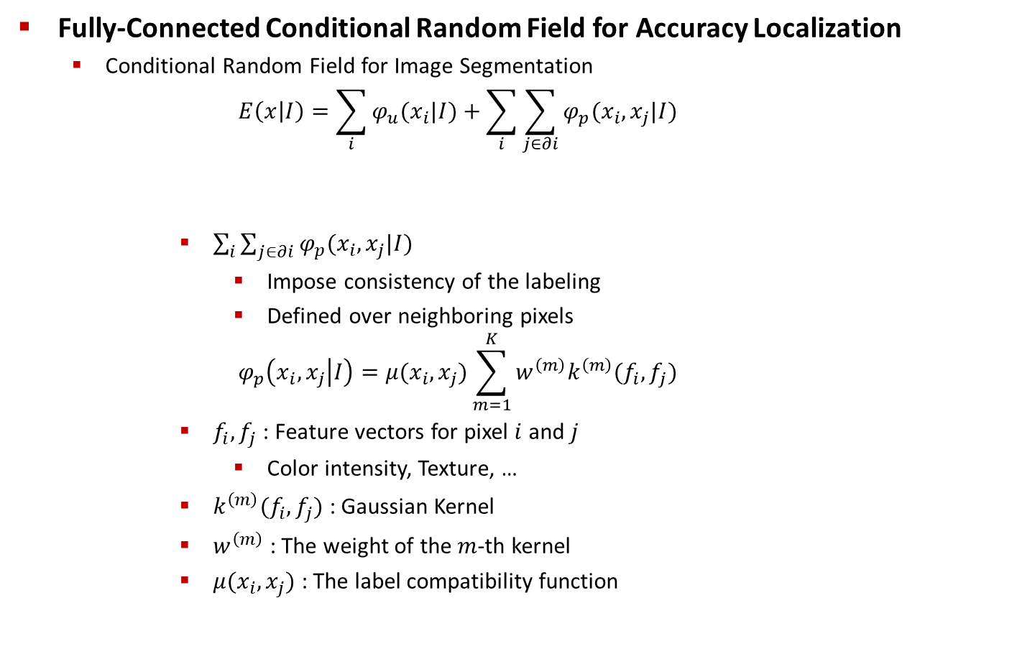
Detailed Boundary Recovery : Fully-Connected Conditional Random Fields and Multi-Scale Prediction
Fully-Connected Conditional Random Field for Accuracy Localization
Conditional Random Field for Image Segmentation
$$E\left(x | I\right)=\sum_{i}{φ_{u}(x_{i}|I)}+\sum_{i}{\sum_{j∈∂i}{φ_{p}(x_{i},x_{j}|I)}}$$
$\sum_{i}{\sum_{j∈∂i}{φ_{p}(x_{i},x_{j}|I)}}$
Impose consistency of the labeling
Defined over neighboring pixels
$$φ_{p}\left(x_{i},x_{j} | I\right)=μ(x_{i},x_{j})\sum_{m=1}^{K}{w^{\left(m\right)}k^{\left(m\right)}(f_{i},f_{j})}$$
$f_{i},f_{j}$ : Feature vectors for pixel $i$ and $j$
Color intensity, Texture, …
$k^{\left(m\right)}(f_{i},f_{j})$ : Gaussian Kernel
$w^{\left(m\right)}$ : The weight of the $m$-th kernel
$μ(x_{i},x_{j})$ : The label compatibility function
Unary Term
Pairwise Term

Slide 13
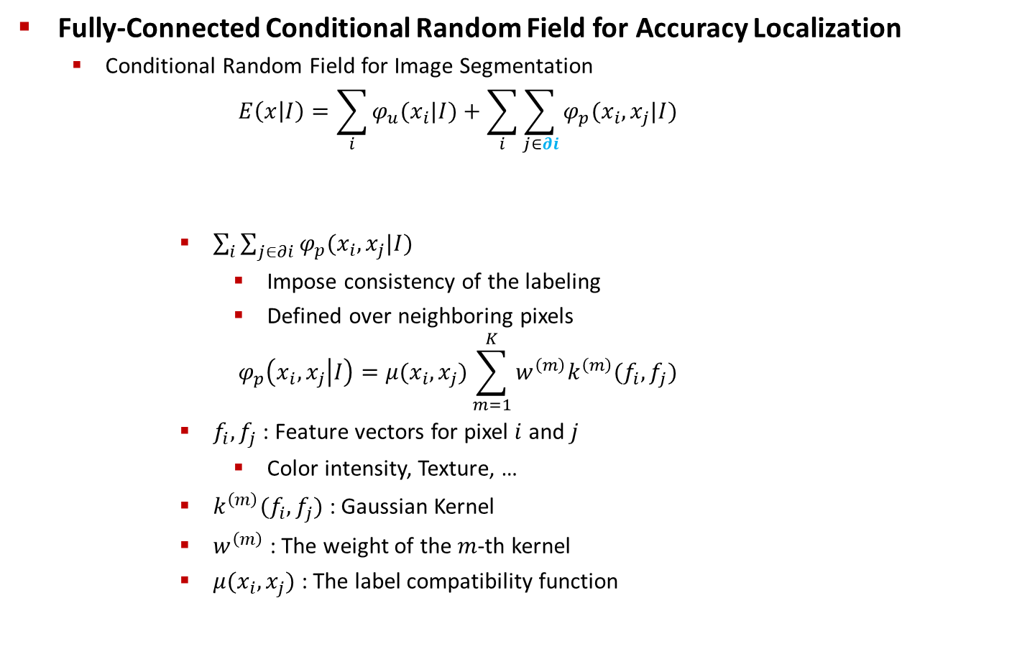
Detailed Boundary Recovery : Fully-Connected Conditional Random Fields and Multi-Scale Prediction
Fully-Connected Conditional Random Field for Accuracy Localization
Conditional Random Field for Image Segmentation
$$E\left(x | I\right)=\sum_{i}{φ_{u}(x_{i}|I)}+\sum_{i}{\sum_{j∈∂i}{φ_{p}(x_{i},x_{j}|I)}}$$
$\sum_{i}{\sum_{j∈∂i}{φ_{p}(x_{i},x_{j}|I)}}$
Impose consistency of the labeling
Defined over neighboring pixels
$$φ_{p}\left(x_{i},x_{j} | I\right)=μ(x_{i},x_{j})\sum_{m=1}^{K}{w^{\left(m\right)}k^{\left(m\right)}(f_{i},f_{j})}$$
$f_{i},f_{j}$ : Feature vectors for pixel $i$ and $j$
Color intensity, Texture, …
$k^{\left(m\right)}(f_{i},f_{j})$ : Gaussian Kernel
$w^{\left(m\right)}$ : The weight of the $m$-th kernel
$μ(x_{i},x_{j})$ : The label compatibility function
Unary Term
Pairwise Term

Slide 14
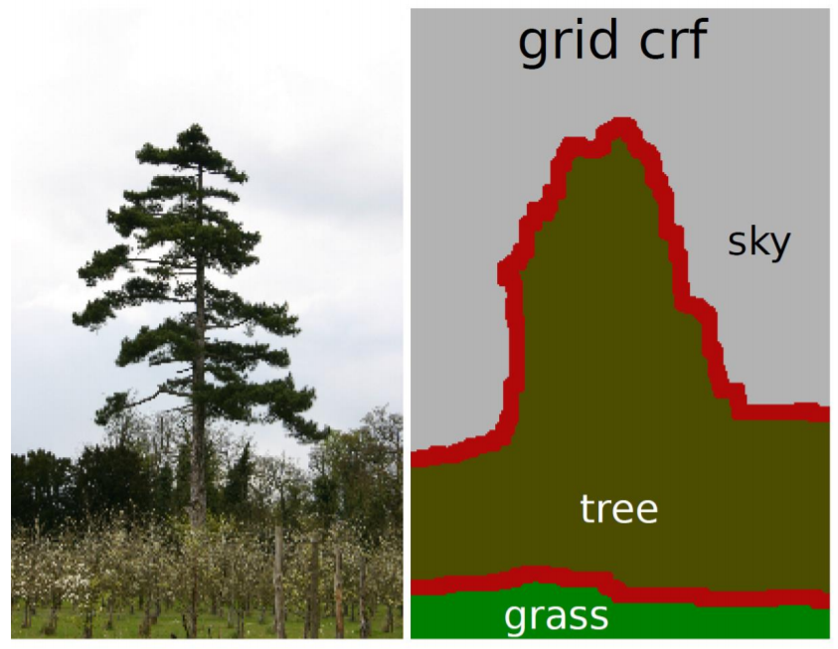
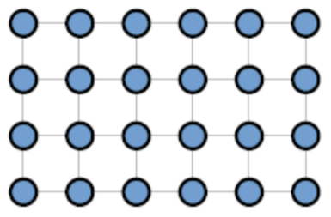
Detailed Boundary Recovery : Fully-Connected Conditional Random Fields and Multi-Scale Prediction
Fully-Connected Conditional Random Field for Accuracy Localization
Conditional Random Field for Image Segmentation
Grid CRF

Slide 15
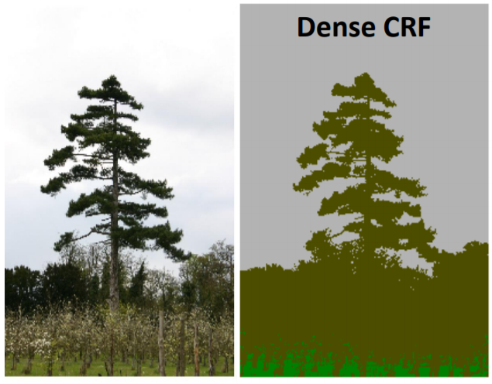
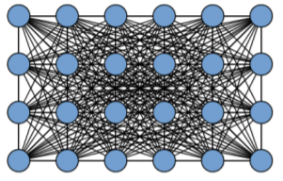
Detailed Boundary Recovery : Fully-Connected Conditional Random Fields and Multi-Scale Prediction
Fully-Connected Conditional Random Field for Accuracy Localization
Conditional Random Field for Image Segmentation
Fully-Connected CRF = Dense CRF ⇒ Find Efficient Inference Algorithm!!!

Slide 16

Detailed Boundary Recovery : Fully-Connected Conditional Random Fields and Multi-Scale Prediction
Fully-Connected Conditional Random Field for Accuracy Localization
Mean Field Approximation
$$Q_{i}\left(x_{i}=l\right)=\frac{1}{Z_{i}}exp⁡\left\{−φ_{u}\left(x_{i}\right)−\sum_{l^{′}∈L}{μ(l,l^{′})}\sum_{m=1}^{K}{w^{\left(m\right)}}\sum_{j≠i}{k^{\left(m\right)}(f_{i},f_{j})Q_{j}\left(l^{′}\right)}\right\}$$
Algorithm
Initialize Q : $Q_{i}\left(x_{i}\right)=\frac{1}{Z_{i}}exp⁡\left\{−φ_{u}\left(x_{i}\right)\right\}$
While not converge : $\tilde{Q_{i}^{\left(m\right)}}(l)=\sum_{j≠i}{k^{\left(m\right)}(f_{i},f_{j})Q_{j}\left(l^{′}\right)}$

Slide 17
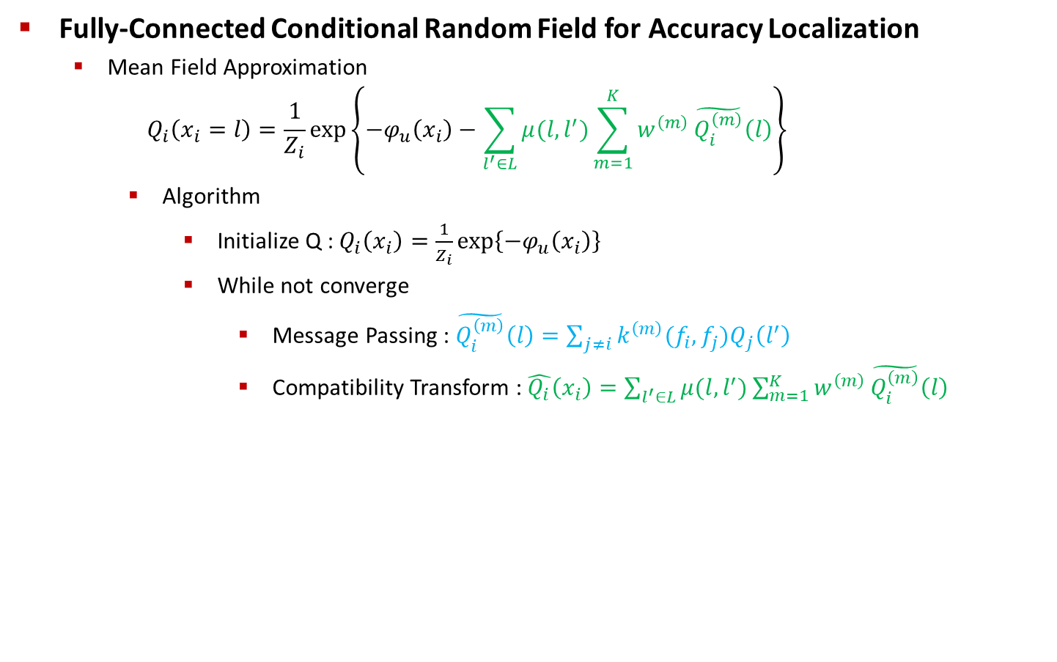
Detailed Boundary Recovery : Fully-Connected Conditional Random Fields and Multi-Scale Prediction
Fully-Connected Conditional Random Field for Accuracy Localization
Mean Field Approximation
$$Q_{i}\left(x_{i}=l\right)=\frac{1}{Z_{i}}exp⁡\left\{−φ_{u}\left(x_{i}\right)−\sum_{l^{′}∈L}{μ(l,l^{′})}\sum_{m=1}^{K}{w^{\left(m\right)}}\tilde{Q_{i}^{\left(m\right)}}\left(l\right)\right\}$$
Algorithm
Initialize Q : $Q_{i}\left(x_{i}\right)=\frac{1}{Z_{i}}exp⁡\left\{−φ_{u}\left(x_{i}\right)\right\}$
While not converge
Message Passing : $\tilde{Q_{i}^{\left(m\right)}}\left(l\right)=\sum_{j≠i}{k^{\left(m\right)}(f_{i},f_{j})Q_{j}\left(l^{′}\right)}$
Compatibility Transform : $\hat{Q_{i}}\left(x_{i}\right)=\sum_{l^{′}∈L}{μ(l,l^{′})}\sum_{m=1}^{K}{w^{\left(m\right)}}\tilde{Q_{i}^{\left(m\right)}}\left(l\right)$

Slide 18
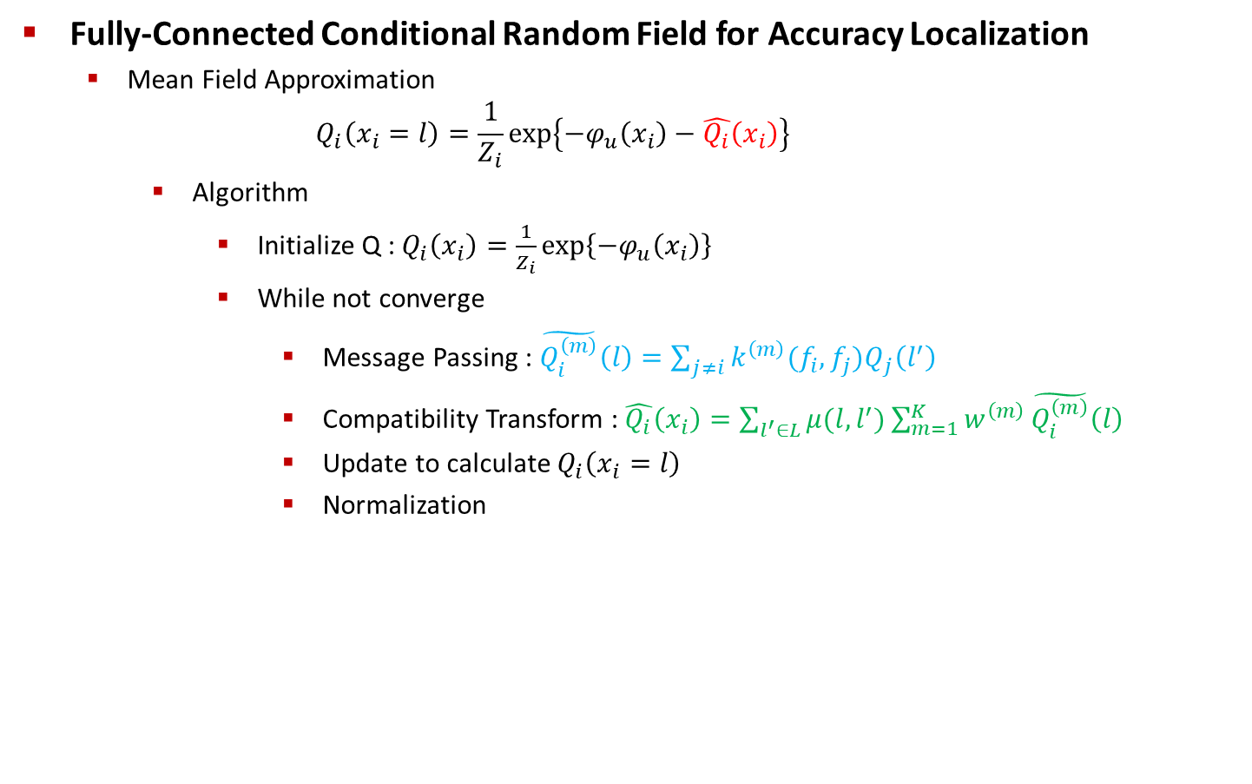
Detailed Boundary Recovery : Fully-Connected Conditional Random Fields and Multi-Scale Prediction
Fully-Connected Conditional Random Field for Accuracy Localization
Mean Field Approximation
$$Q_{i}\left(x_{i}=l\right)=\frac{1}{Z_{i}}exp⁡\left\{−φ_{u}\left(x_{i}\right)−\hat{Q_{i}}\left(x_{i}\right)\right\}$$
Algorithm
Initialize Q : $Q_{i}\left(x_{i}\right)=\frac{1}{Z_{i}}exp⁡\left\{−φ_{u}\left(x_{i}\right)\right\}$
While not converge
Message Passing : $\tilde{Q_{i}^{\left(m\right)}}\left(l\right)=\sum_{j≠i}{k^{\left(m\right)}(f_{i},f_{j})Q_{j}\left(l^{′}\right)}$
Compatibility Transform : $\hat{Q_{i}}\left(x_{i}\right)=\sum_{l^{′}∈L}{μ(l,l^{′})}\sum_{m=1}^{K}{w^{\left(m\right)}}\tilde{Q_{i}^{\left(m\right)}}\left(l\right)$
Update to calculate $Q_{i}\left(x_{i}=l\right)$
Normalization

Slide 19

Detailed Boundary Recovery : Fully-Connected Conditional Random Fields and Multi-Scale Prediction
Fully-Connected Conditional Random Field for Accuracy Localization
Mean Field Approximation
$$Q_{i}\left(x_{i}=l\right)=\frac{1}{Z_{i}}exp⁡\left\{−φ_{u}\left(x_{i}\right)−\hat{Q_{i}}\left(x_{i}\right)\right\}$$
Algorithm
Initialize Q : $Q_{i}\left(x_{i}\right)=\frac{1}{Z_{i}}exp⁡\left\{−φ_{u}\left(x_{i}\right)\right\}$
While not converge
Message Passing : $\tilde{Q_{i}^{\left(m\right)}}\left(l\right)=\sum_{j≠i}{k^{\left(m\right)}(f_{i},f_{j})Q_{j}\left(l^{′}\right)}$
Compatibility Transform : $\hat{Q_{i}}\left(x_{i}\right)=\sum_{l^{′}∈L}{μ(l,l^{′})}\sum_{m=1}^{K}{w^{\left(m\right)}}\tilde{Q_{i}^{\left(m\right)}}\left(l\right)$
Update to calculate $Q_{i}\left(x_{i}=l\right)$
Normalization
$$O(N^{2})$$

Slide 20

Detailed Boundary Recovery : Fully-Connected Conditional Random Fields and Multi-Scale Prediction
Fully-Connected Conditional Random Field for Accuracy Localization
Mean Field Approximation with Efficient Message Passing
$$\tilde{Q_{i}^{\left(m\right)}}\left(l\right)=\sum_{j≠i}{k^{\left(m\right)}(f_{i},f_{j})Q_{j}\left(l^{′}\right)}$$
$k^{\left(m\right)}(f_{i},f_{j})$ : Gaussian Kernel
Apply Convolution between $k^{\left(m\right)}(f_{i},f_{j})$ and $Q_{j}\left(l^{′}\right)$

Slide 21

Detailed Boundary Recovery : Fully-Connected Conditional Random Fields and Multi-Scale Prediction
Fully-Connected Conditional Random Field for Accuracy Localization
Mean Field Approximation with Efficient Message Passing
$$\tilde{Q_{i}^{\left(m\right)}}\left(l\right)=\sum_{j≠i}{k^{\left(m\right)}(f_{i},f_{j})Q_{j}\left(l^{′}\right)}=\left[G^{(m)}∗Q(l)\right]−Q_{j}\left(l^{′}\right)$$
$k^{\left(m\right)}(f_{i},f_{j})$ : Gaussian Kernel
Apply Convolution between $k^{\left(m\right)}(f_{i},f_{j})$ and $Q_{j}\left(l^{′}\right)$

Slide 22
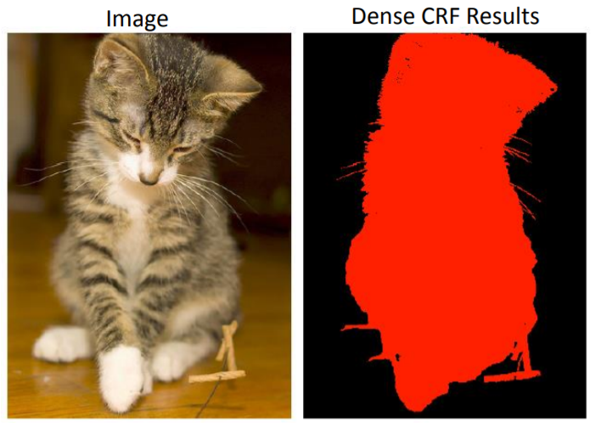
Detailed Boundary Recovery : Fully-Connected Conditional Random Fields and Multi-Scale Prediction
Fully-Connected Conditional Random Field for Accuracy Localization
Conditional Random Field for Image Segmentation

Slide 23
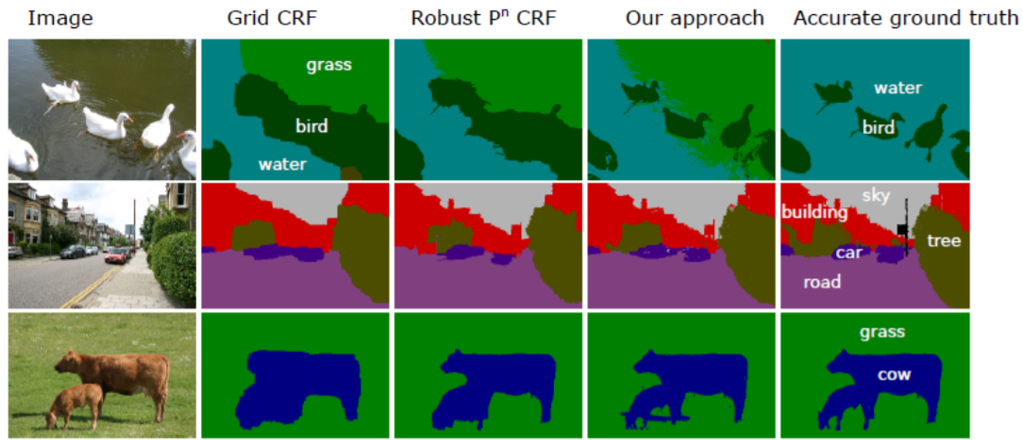
Detailed Boundary Recovery : Fully-Connected Conditional Random Fields and Multi-Scale Prediction
Fully-Connected Conditional Random Field for Accuracy Localization
Conditional Random Field for Image Segmentation

Slide 24
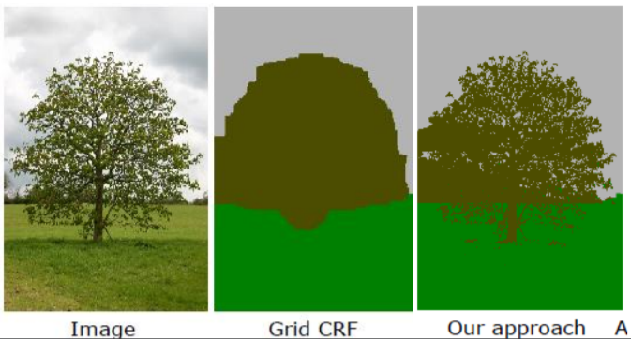
Detailed Boundary Recovery : Fully-Connected Conditional Random Fields and Multi-Scale Prediction
Fully-Connected Conditional Random Field for Accuracy Localization
Conditional Random Field for Image Segmentation

Slide 25
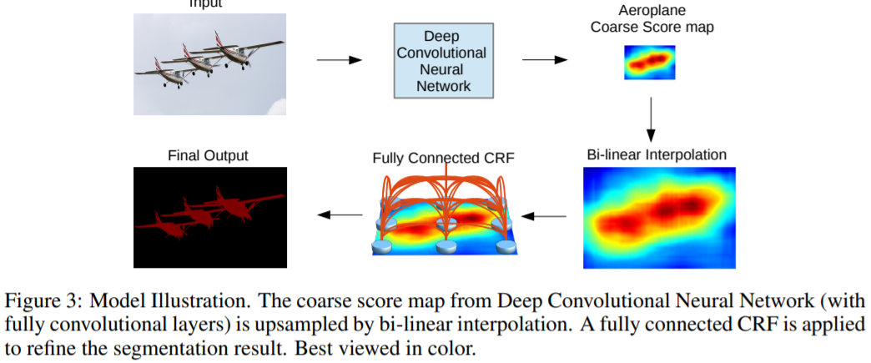
Detailed Boundary Recovery : Fully-Connected Conditional Random Fields and Multi-Scale Prediction
Fully-Connected Conditional Random Field for Accuracy Localization
DeepLab Model

Slide 26
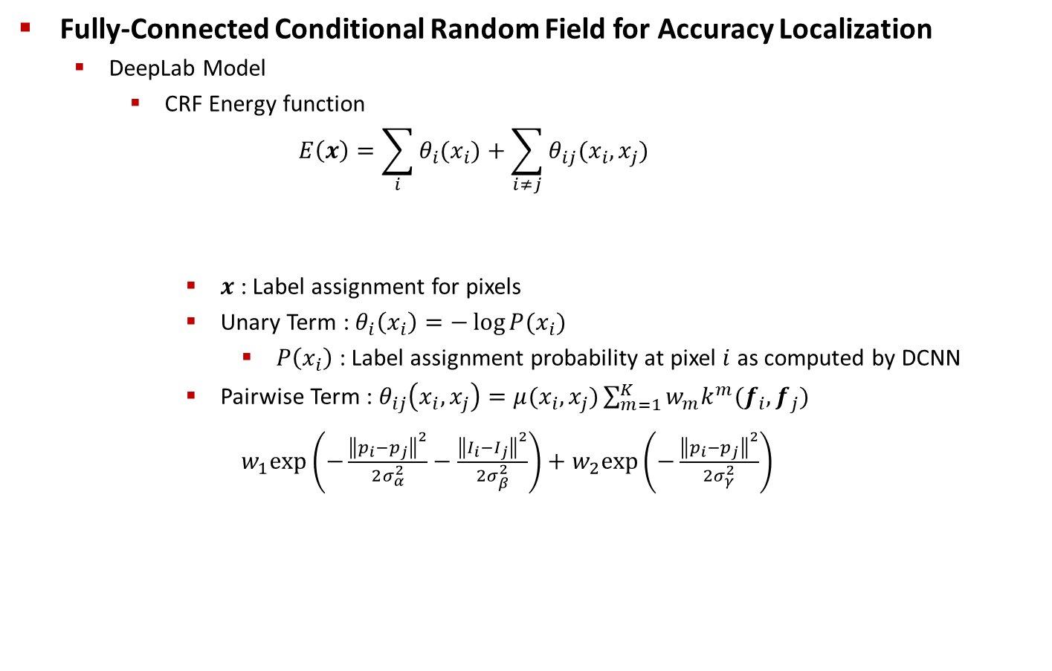
Detailed Boundary Recovery : Fully-Connected Conditional Random Fields and Multi-Scale Prediction
Fully-Connected Conditional Random Field for Accuracy Localization
DeepLab Model
CRF Energy function
$$E\left(x\right)=\sum_{i}{θ_{i}(x_{i})}+\sum_{i≠j}{θ_{ij}(x_{i},x_{j})}$$
$x$ : Label assignment for pixels
Unary Term : $θ_{i}\left(x_{i}\right)=−\log{P(x_{i})}$
$P\left(x_{i}\right)$ : Label assignment probability at pixel $i$ as computed by DCNN
Pairwise Term : $θ_{ij}\left(x_{i},x_{j}\right)=μ(x_{i},x_{j})\sum_{m=1}^{K}{w_{m}k^{m}(f_{i},f_{j})}$
$w_{1}exp\left(−\frac{{\left\|p_{i}−p_{j}\right\|}^{2}}{2σ_{α}^{2}}−\frac{{\left\|I_{i}−I_{j}\right\|}^{2}}{2σ_{β}^{2}}\right)+w_{2}exp\left(−\frac{{\left\|p_{i}−p_{j}\right\|}^{2}}{2σ_{γ}^{2}}\right)$
Unary Term
Pairwise Term
Position + Color Intensity
Position

Slide 27
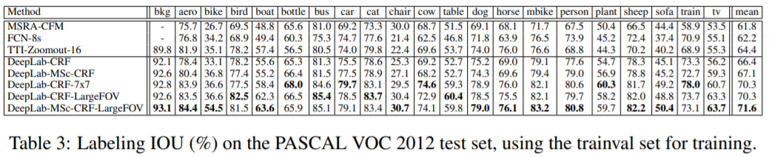
Experimental Evaluation
Results

Slide 28
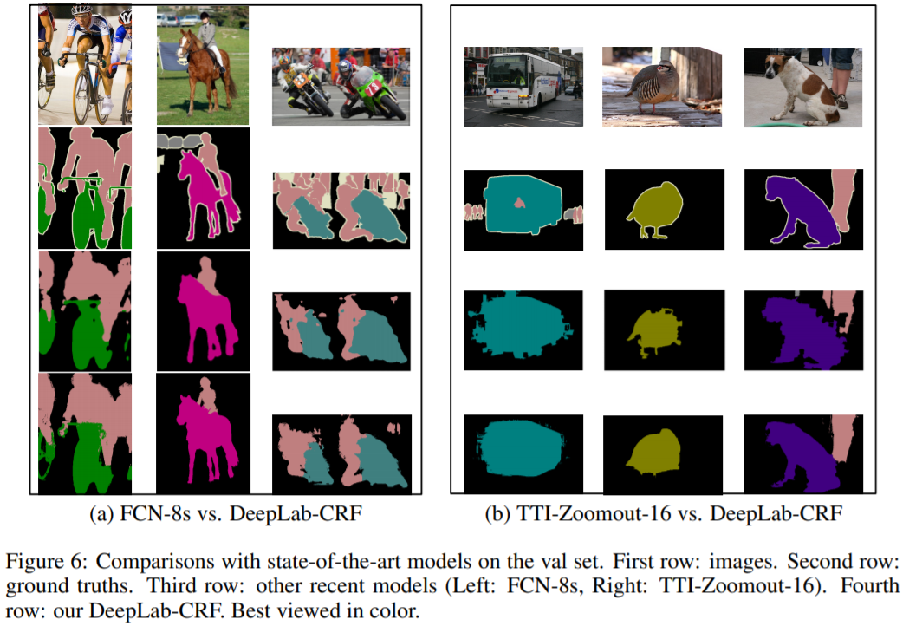
Experimental Evaluation
Results

